Slide 1
Network Infrastructure Project: Epidemic models for VANET message dissemination

Slide 2
Presentation of the problem
Let’s consider a contact graph of vehicles. This vehicles are represented by points on a city map.

Slide 3
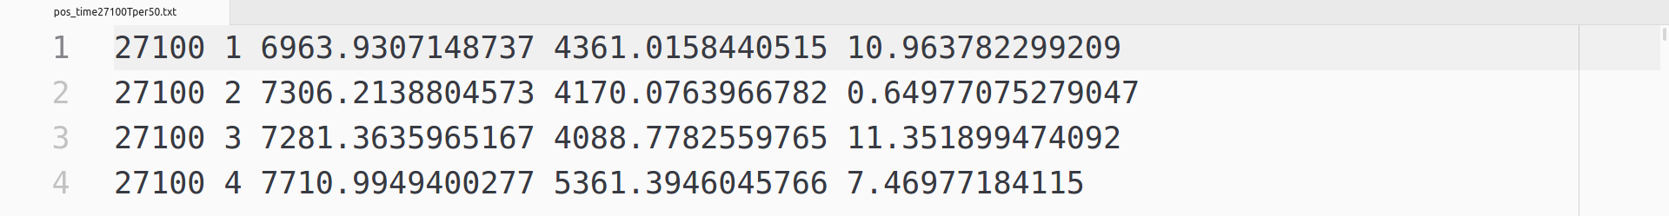
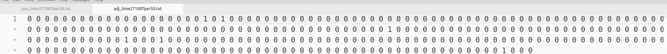
Presentation of the problem
This graph is been given to us under the form of two text files (for each Cologne, Luxembourg and New York).
The first is about the position of vehicles on the map.
The second defines, for each line, the adjacent vehicles from the one about that line.

Slide 4
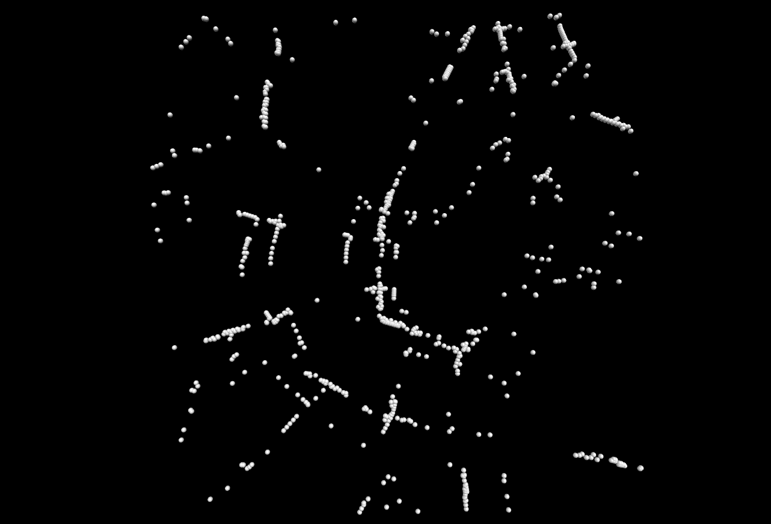
Presentation of the problem
At first we have to translate these files to a visual graph.

Slide 5
Presentation of the problem
Then we have to create a dissemination algorithm of messages trough our vehicles in order to reach the higher number of “infected” nodes, without overcharge (?) the network.
In other words the aim of this project is to test the accuracy of epidemic models in predicting the fraction of relay nodes and the fraction of reached nodes.

Slide 6
Presentation of the problem
Vehicles communicate through a VANET using the IEEE 802.11p standard (the modeling must account at least for the spurious forwarding effect).

Slide 7
Presentation of the problem
The program will play visually our algorithm and it will display result values on terminal.

Slide 8
Presentation of the problem
We decided to use Python as programming language and its libraries VPython, in order to display our visual graph of vehicles and the dissemination of the message, and Matplotlib, in order to generate plots.

Slide 9
Algorithm’s description
Our algorithm runs for each vehicle and it returns whether or not a car must re-broadcast a message.

Slide 10
Algorithm’s description
After receiving a message, each car starts a timer more or less large based on the distance from the last emitter. During this timer, the car will wait for other messages arriving.
The lists of these messages’ emitters will be the central theme of our algorithm.

Slide 11
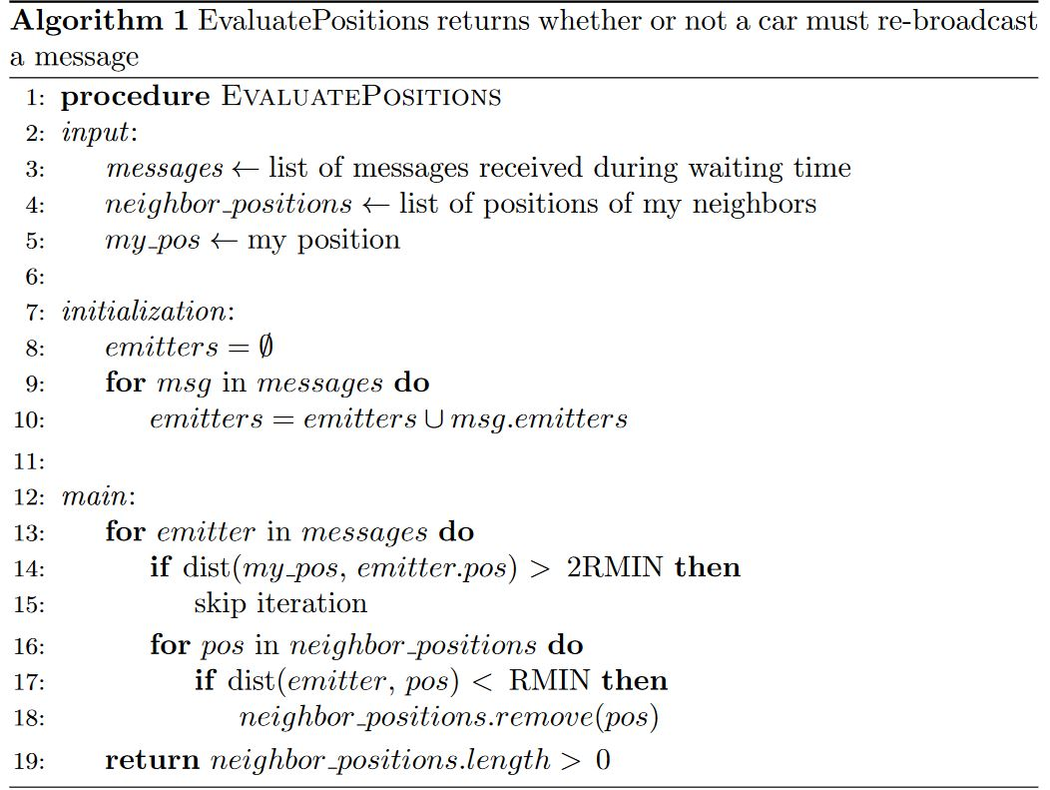
Algorithm’s description
In the first part of the main function, for each emitter who relayed the message, if it is very far from me, then I will ignore it.

Slide 12
Algorithm’s description
Instead, about emitters not so far from me, if some of my neighbours are NOT contained in emitters’ radius of action, then I will broadcast.

Slide 13
Result’s Presentation
Now we can measure the accuracy of our epidemic model, by plots which show the relationship between emitters’ radius of action (RMIN), that we decided before the test, and the percentage of forwarding or reached vehicles.

Slide 14
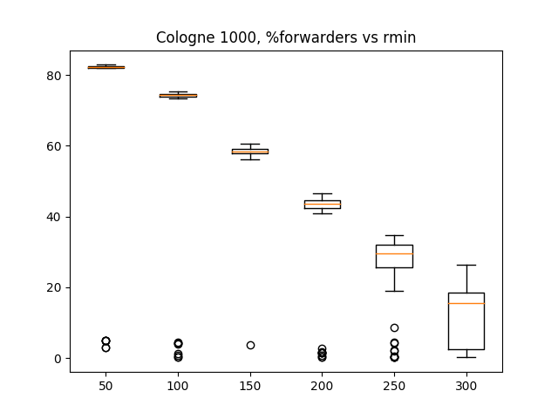
Result’s Presentation - % of forwarders

Slide 15
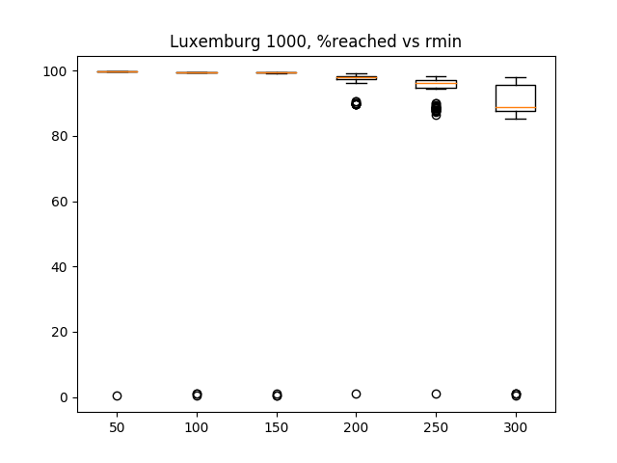
Result’s Presentation - % of reached nodes

Slide 16
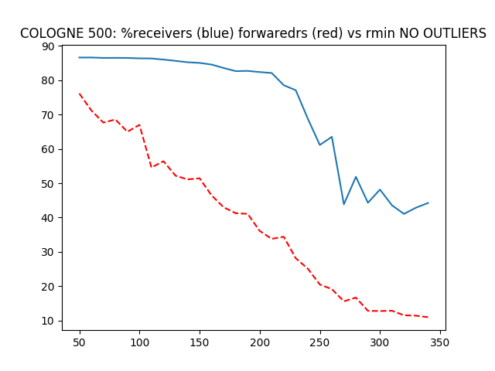
Result’s Presentation - Cartesian coordinate system NO OUTLIERS

Slide 17
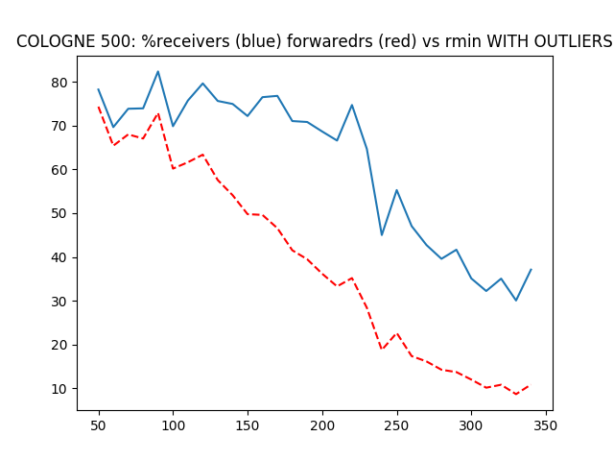
Result’s Presentation - Cartesian coordinate system WITH OUTLIERS

